Slide 1
Temporal system state
aggregation based on:
Interpretable machine learning
Net demand
Operating cost
Crucial features
Line benefits
Hourly investments
Sets of representative periods
Selection of set
Input data
Optimization model
Relaxed
optimization model
Reduced optimization model
Results
Results
Results

Slide 2
Interpretable machine learning
Crucial features
Temporal system state aggregation
Representative periods
Input data
Optimization model
Relaxed
optimization model
Reduced optimization model
Results
Results
Results

Slide 3
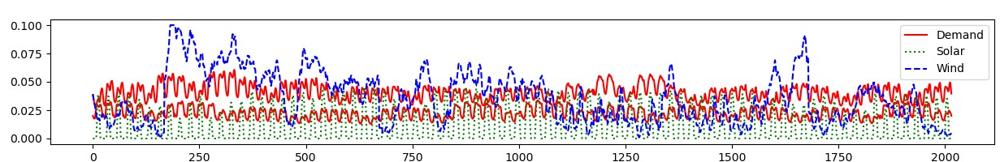
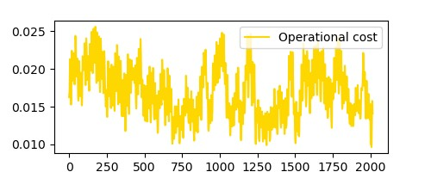
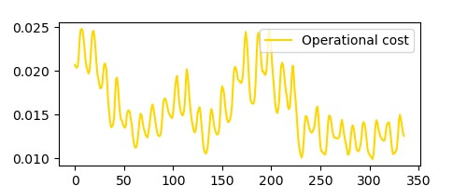
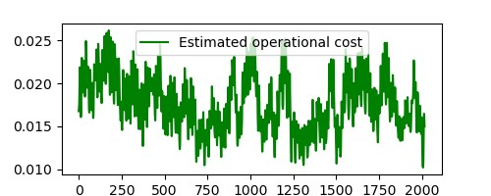
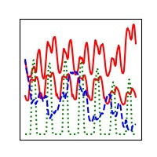
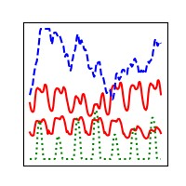
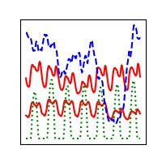
Relaxed ESOM
Relaxed ESOM
Features
Clustering
Method
Clustering
Method
Training
Evaluation
Clustering
Method
Representative Time Series
ML algorithm
NN-assisted ex-post clustering
No temporal reduction
Input-based clustering
Ex-post clustering
ESOM
ESOM
ESOM
ESOM

